Slide 1
Data Structure (KCS301) Unit - 1
-Dr. Amit Kumar Tiwari

Slide 2
Content
Introduction to Data structure
Definition
Essentials of C language

Slide 3
What is data Structure
A data structure is a particular way of organizing and storing data in a computer so that it can be accessed and modified efficiently.
or
A data structure is a collection of data values, the relationships among them, and the functions or operations that can be applied to the data.

Slide 4
Need of data Structure

Slide 5
Type of data structure
According to nature of size
Static data structure
Dynamic data structure
According to its occurrence
Linear data structure
Non-linear data structure
Primitive and non-primitive
Homogeneous and non-homogeneous

Slide 6
Type of data structure
According to nature of size
Static data structure
Dynamic data structure
According to its occurrence
Linear data structure
Non-linear data structure
Primitive and non-primitive
Homogeneous and non-homogeneous

Slide 7
Type of data structure
According to nature of size
Static data structure: A data structure said to be static if we can store data up to a fix number. Eg: Array.
Dynamic data structure
According to its occurrence
Linear data structure
Non-linear data structure
Primitive and non-primitive
Homogeneous and non-homogeneous

Slide 8
Type of data structure
According to nature of size
Static data structure
Dynamic data structure:
According to its occurrence
Linear data structure
Non-linear data structure
Primitive and non-primitive
Homogeneous and non-homogeneous

Slide 9
Type of data structure
According to nature of size
Static data structure
Dynamic data structure: which allows programmer to change its size during program execution to add or delete data. E.g.. Link list, tree, graph etc.
According to its occurrence
Linear data structure
Non-linear data structure
Primitive and non-primitive
Homogeneous and non-homogeneous

Slide 10
Type of data structure
According to nature of size
Static data structure
Dynamic data structure
According to its occurrence
Linear data structure
Non-linear data structure
Primitive and non-primitive
Homogeneous and non-homogeneous

Slide 11
Type of data structure
According to nature of size
Static data structure
Dynamic data structure
According to its occurrence
Linear data structure: data stored in consecutive memory location or in a sequential form. E.g. array, link list, queue, stack etc.
Non-linear data structure
Primitive and non-primitive
Homogeneous and non-homogeneous

Slide 12
Type of data structure
According to nature of size
Static data structure
Dynamic data structure
According to its occurrence
Linear data structure
Non-linear data structure
Primitive and non-primitive
Homogeneous and non-homogeneous

Slide 13
Type of data structure
According to nature of size
Static data structure
Dynamic data structure
According to its occurrence
Linear data structure
Non-linear data structure: data stored in non consecutive memory location or in inconsequential form. E.g. tree, graph etc.
Primitive and non-primitive
Homogeneous and non-homogeneous

Slide 14
Data Structure
Phisical Data Structure
Logical Data Structure
Non linear Data Structure
Linear Data Structure
E.g: int, char, float
E.g.. Array, Link List, Queue
Tree, graph

Slide 15
Type of data structure
According to nature of size
Static data structure
Dynamic data structure
According to its occurrence
Linear data structure
Non-linear data structure
Primitive and non-primitive
Homogeneous and non-homogeneous

Slide 16
Type of data structure
According to nature of size
Static data structure
Dynamic data structure
According to its occurrence
Linear data structure
Non-linear data structure
Primitive and non-primitive Data Structure
Homogeneous and non-homogeneous

Slide 17
Primitive and non-primitive Data Structure
Primitive Data Structure
The term "data type" and "primitive data type" are often used interchangeably. Primitive data types are predefined types of data, which are supported by the programming language. For example, integer, character, and string are all primitive data types.
Non-primitive Data Structure:
Non-primitive data types are not defined by the programming language, but are instead created by the programmer.

Slide 18
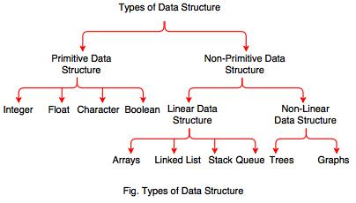
Primitive and non-primitive Data Structure

Slide 19
Type of data structure
According to nature of size
Static data structure
Dynamic data structure
According to its occurrence
Linear data structure
Non-linear data structure
Primitive and non-primitive Data Structure
Homogeneous and non-homogeneous

Slide 20
Homogeneous data: Homogeneous data structures are those data structures that contain only similar type of data e.g. like a data structure containing only integer or float values. The simplest example of such type of data structures is an Array.

Slide 21
Heterogeneous Data: Heterogeneous Data Structures are those data structures that contains a variety or dissimilar type of data, for e.g. a data structure that can contain various data of different data types like integer, float and character. The examples of such data structures include structures, union etc.

Slide 22
Data type vs Data structure
Data type=Permitted Data values+operations
Data Structure= Organized Data+ Allowed Operation

Slide 23
Data Structure Operations
1.Traversing
2. Searching
3. Inserting
4. Deleting
5. Sorting
6. Merging
7. Creating

Slide 24
Algorithm
An Algorithm is a method, written in your own language without using any special symbol, by which we can solve a particular problem.

Slide 25
Type of Analysis
We can have three cases to analyze an algorithm: 1) Worst Case 2) Average Case 3) Best Case

Slide 26
Type of Analysis
We can have three cases to analyze an algorithm: 1) Worst Case Analysis (Usually Done) In the worst case analysis, we calculate upper bound on running time of an algorithm. We must know the case that causes maximum number of operations to be executed.
2) Average Case 3) Best Case

Slide 27
Type of Analysis
We can have three cases to analyze an algorithm: 1) Worst Case 2) Average Case Analysis (Sometimes done)
In average case analysis, we take all possible inputs and calculate computing time for all of the inputs.
3) Best Case

Slide 28
Type of Analysis
We can have three cases to analyze an algorithm: 1) Worst Case 2) Average Case 3) Best Case Analysis (Bogus)
In the best case analysis, we calculate lower bound on running time of an algorithm. We must know the case that causes minimum number of operations to be executed.

Slide 29
Asymptotic Notations
The goal of computational complexity is to classify algorithms according to their performances.
Definition of "big Oh"

Slide 30
big Oh (Asymptotic Notation for upper bound worst case)
For any monotonic functions f(n) and g(n) from the positive integers to the positive integers, we say that f(n) = O(g(n)) when there exist constants c > 0 and n₀ > 0 such that
f(n) ≤ c * g(n), for all n ≥ n₀
Intuitively, this means that function f(n) does not grow faster than g(n), or that function g(n) is an upper bound for f(n), for all sufficiently large n→∞
Here is a graphic representation of f(n) = O(g(n)) relation:

Slide 31
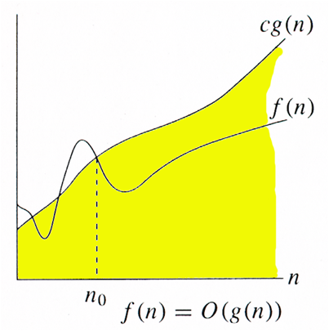
big Oh
Here is a graphic representation of f(n) = O(g(n)) relation:

Slide 32
Definition of “Big Omega“ asymptotic lower bound-best case
We need the notation for the lower bound. A capital omega Ω notation is used in this case. We say that f(n) = Ω(g(n)) when there exist constant c that f(n) ≥ c*g(n) for for all sufficiently large n.

Slide 33
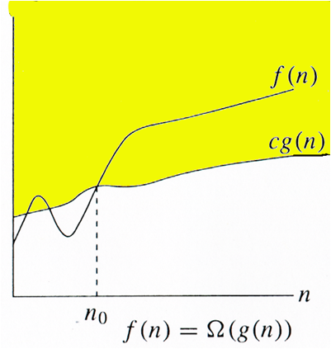
Definition of “Big Omega“ asymptotic lower bound-best case

Slide 34
Definition of "big Theta“ asymptotically tight bound -avarage case
To measure the complexity of a particular algorithm, means to find the upper and lower bounds. A new notation is used in this case. We say that f(n) = Θ(g(n)) if and only f(n) = O(g(n)) and f(n) = Ω(g(n)).

Slide 35
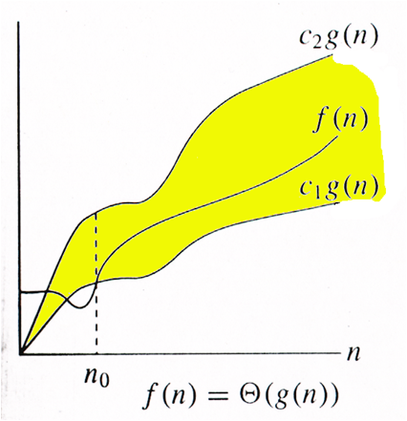

Slide 36
Algorithm Efficiency
Time complexity is a function describing the amount of time an algorithm takes in terms of the amount of input to the algorithm.
Space complexity is a function describing the amount of memory (space) an algorithm takes in terms of the amount of input to the algorithm.

Slide 37
Array
An array is a collection of similar data elements. These data elements have the same data type.
The elements of the array are stored in consecutive memory locations and are referenced by an index (also known as the subscript).
We can declare an array as
data_type Array_name[size];
eg: int A[5];
char A[5];

Slide 38
index
0
1
2
3
4
4124
4126
4128
4130
4132
Base Address
A[2]
int A[5];

Slide 39
Type of Array
1 D Array
Eg: int A[5];
2 D Array
Eg: int A[5][4];
3 D Array
Eg: int A[5][4][2];
n D Array
Eg: int A[5]………….[1];

Slide 40
Memmory allocation in 1D array
Address of data element,
A[k] = BA(A) + w(k – lower_bound)
Here, A is the array, k is the index of the element of which we have to calculate the address, BA is the base address of the array A, and w is the size of one element in memory, for example, size of int is 2.

Slide 41
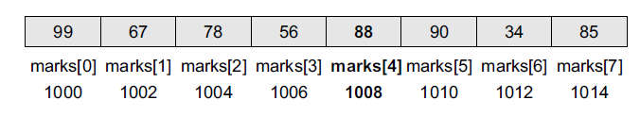
Que) Given an array int marks[]={99,67,78,56,88,90,34,85}, calculate address of marks[4] if the base address=1000.
Solution
We know that storing an integer value requires 2 bytes, therefore, its size is 2 bytes.
marks[4] = 1000 + 2(4 – 0)
= 1000 + 2(4) = 1008

Slide 42
Calculating the Length of an Array
Length = upper_bound – lower_bound + 1
where upper_bound is the index of the last element and lower_bound is the index of the first element in the array.

Slide 43
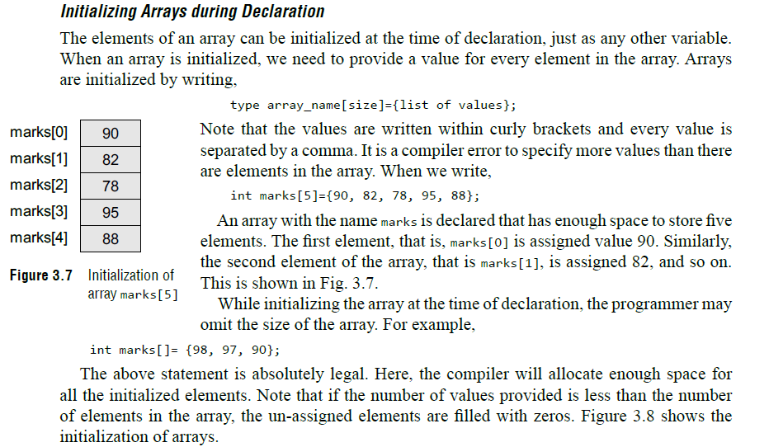

Slide 44
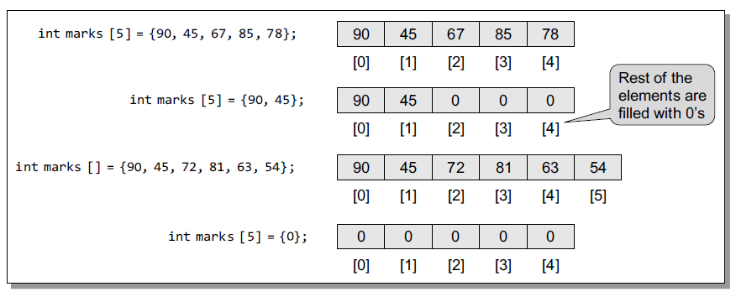

Slide 45
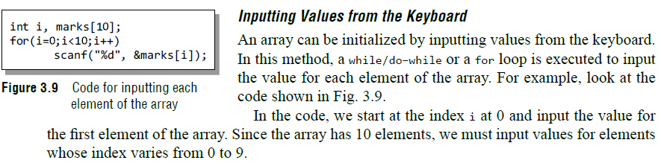

Slide 46
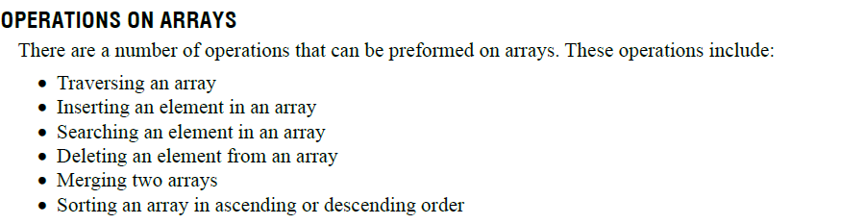

Slide 47
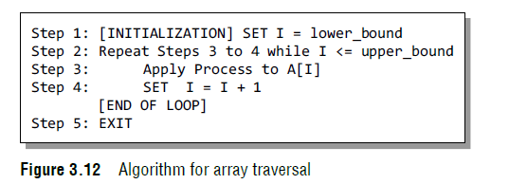
Traversing an array

Slide 48
Write a program to read and display n numbers using an array.
#include <stdio.h>
#include <conio.h>
int main()
{
int i, n, arr[20];
clrscr();
printf("\n Enter the number of elements in the array : ");
scanf("%d", &n);
for(i=0;i<n;i++)
{
printf("\n arr[%d] = ", i);
scanf("%d",&arr[i]);
}
printf("\n The array elements are ");
for(i=0;i<n;i++)
printf("\t %d", arr[i]);
return 0;
}

Slide 49
output
Enter the number of elements in the array : 5
arr[0] = 1
arr[1] = 2
arr[2] = 3
arr[3] = 4
arr[4] = 5
The array elements are 1 2 3 4 5

Slide 50
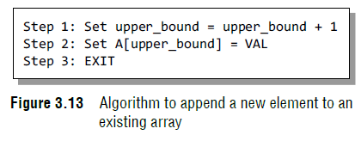
Inserting an Element in an Array

Slide 51
Algorithm to Insert an Element in the Middle of an Array
The algorithm INSERT will be declared as INSERT (A, N, POS, VAL). The arguments are
(a) A, the array in which the element has to be inserted
(b) N, the number of elements in the array
(c) POS, the position at which the element has to be inserted
(d) VAL, the value that has to be inserted

Slide 52
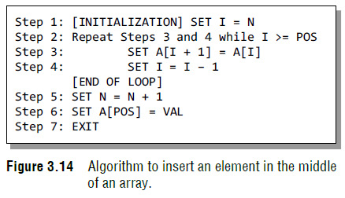

Slide 53
Write a program to insert a number at a given location in an array.
#include<stdio.d>
#include <conio.h>
int main()
{
int i, n, num, pos, arr[10];
clrscr();
printf("\n Enter the number of elements in the array : ");
scanf("%d", &n);
for(i=0;i<n;i++)
{
printf("\n arr[%d] = ", i);
scanf("%d", &arr[i]);
}
printf("\n Enter the number to be inserted : ");
scanf("%d", &num);
printf("\n Enter the position at which the number has to be added : ");
scanf("%d", &pos);
for(i=n–1;i>=pos;i––)
arr[i+1] = arr[i];
arr[pos] = num;
n = n+1;
printf("\n The array after insertion of %d is : ", num);
for(i=0;i<n;i++)
printf("\n arr[%d] = %d", i, arr[i]);
getch();
return 0;
}

Slide 54
Output
Enter the number of elements in the array : 5
arr[0] = 1
arr[1] = 2
arr[2] = 3
arr[3] = 4
arr[4] = 5
Enter the number to be inserted : 0
Enter the position at which the number has to be added : 3
The array after insertion of 0 is :
arr[0] = 1
arr[1] = 2
arr[2] = 3
arr[3] = 0
arr[4] = 4
arr[5] = 5

Slide 55
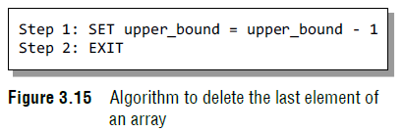
Deleting an Element from an Array

Slide 56
Algorithm to delete an element from the middle of an array
The algorithm DELETE will be declared as DELETE(A, N,
POS). The arguments are:
(a) A, the array from which the element has to be deleted
(b) N, the number of elements in the array
(c) POS, the position from which the element has to
be deleted

Slide 57
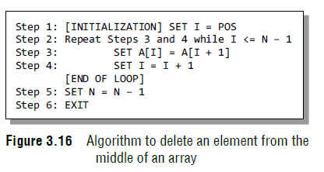

Slide 58
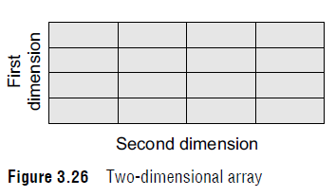
Declaring Two-dimensional Arrays
data_type array_name[row_size][column_size];
int marks[3][5];

Slide 59
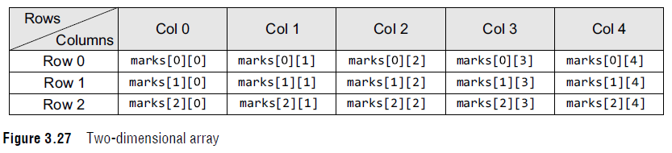

Slide 60
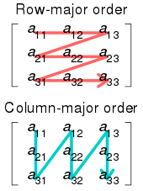
Memory allocation

Slide 61
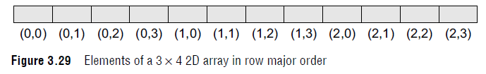
row major order

Slide 62
row major order
The Location of element A[i, j] can be obtained by
LOC (A [i, j]) = Base_Address + W [M (i) + (j)] Here, Base_Address is the address of first element in the array. W is the word size. It means number of bytes occupied by each element. N is number of rows in array. M is number of columns in array.

Slide 63
we want to calculate the address of element A [1, 2].
It can be calculated as follow:
Here,
Base_Address = 2000, W= 2, M=4, N=2, i=1, j=2
LOC (A [i, j]) = Base_Address + W [M (i) + (j)]
LOC (A[1, 2]) = 2000 + 2 *[4*(1) + 2]
= 2000 + 2 * [4 + 2]
= 2000 + 2 * 6
= 2000 + 12
= 2012

Slide 64
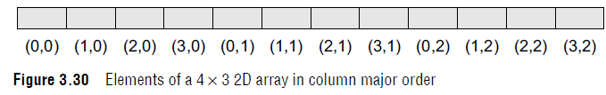
Column Major Order

Slide 65
Column Major Order
The Location of element A[i, j] can be obtained by
LOC (A [i, j]) = Base_Address + W [N (j) + (i)] Here, Base_Address is the address of first element in the array. W is the word size. It means number of bytes occupied by each element. N is number of rows in array. M is number of columns in array.

Slide 66
we want to calculate the address of element A [1, 2].
It can be calculated as follow:
Here,
Base_Address = 2000, W= 2, M=4, N=2, i=1, j=2
LOC (A [i, j]) = Base_Address + W [N (j) + (i)]
LOC (A[1, 2]) = 2000 + 2 *[2*(2) + 1]
= 2000 + 2 * [4 + 1]
= 2000 + 2 * 5
= 2000 + 10
= 2010

Slide 67
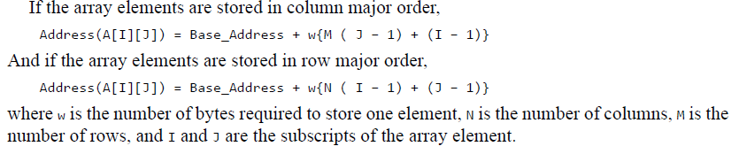

Slide 68
Sparse Matrix and its representations
A matrix is a two-dimensional data object made of m rows and n columns, therefore having total m x n values. If most of the elements of the matrix have 0 value, then it is called a sparse matrix.

Slide 69
Sparse Matrix and its representations
Why to use Sparse Matrix instead of simple matrix ?
Storage: There are lesser non-zero elements than zeros and thus lesser memory can be used to store only those elements.
Computing time: Computing time can be saved by logically designing a data structure traversing only non-zero elements..
Example:
0 0 3 0 4
0 0 5 7 0
0 0 0 0 0
0 2 6 0 0

Slide 70
storing non-zero elements with triples- (Row, Column, value)
Sparse Matrix Representations can be done in many ways following are two common representations:
Array representation
Linked list representation

Slide 71
Array representation
2D array is used to represent a sparse matrix in which there are three rows named as
Row: Index of row, where non-zero element is located
Column: Index of column, where non-zero element is located
Value: Value of the non zero element located at index – (row,column)

Slide 72
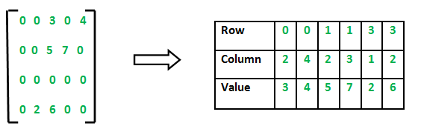

Slide 73
Using Linked Lists
In linked list, each node has four fields. These four fields are defined as:
Row: Index of row, where non-zero element is located
Column: Index of column, where non-zero element is located
Value: Value of the non zero element located at index – (row,column)
Next node: Address of the next node

Slide 74
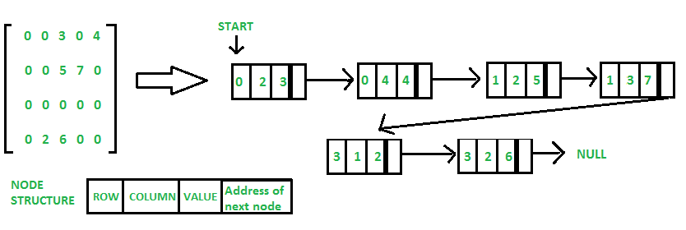

Slide 75
Will Continue in next lecture…

